Slide 1

Defining Classes
Classes, Fields, Constructors, Methods
SoftUni Team
Technical Trainers
Software University
http://softuni.bg

Slide 2

Table of Contents
Defining Simple Classes
Fields
Constructors, keyword this
Methods
Static Members

Slide 3
Questions?
sli.do
#java-fund

Slide 4

Defining Classes

Slide 5
Defining Simple Classes
Specification of a given type of objects from the real-world
Classes provide structure for describing and creating objects
Class name
Keyword
class Car {
…
}
Class body

Slide 6


Naming Classes
Use PascalCase naming
Use descriptive nouns
Avoid ambiguous names
class Dice { … }
class BankAccount { … }
class IntegerCalculator { … }
class TPMF { … }
class bankaccount { … }
class numcalc { … }

Slide 7
Class Members
Class is made up of state and behavior
Fields store state
Methods describe behaviour
class Car {
String make ;
String model;
void start(){ … }
}
class Dog {
int age;
string type;
void bark(){ … }
}
Fields
Fields
Method
Method

Slide 8

Creating an Object
A class can have many instances (objects)
class Program {
public static void Main()
{
Car firstCar = new Car();
Car secondCar = new Car();
}
}
Use the new keyword
Variable stores a reference

Slide 9
Object Reference
Declaring a variable creates a reference in the stack
The new keyword allocates memory on the heap
Car car = new Car();
STACK
HEAP
obj
diceD6
(1540e19d)
type = null
sides = 0

Slide 10
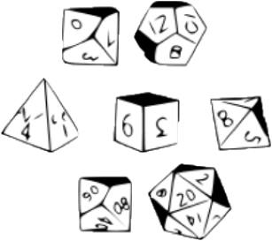

Classes vs. Objects
Classes provide structure for describing and creating objects
An object is a single instance of a class
Dice (Class)
D6 Dice (Object)

Slide 11

Class Data
Storing Data Inside a Class

Slide 12
Fields
Class fields have access modifiers, type and name
public class Car {
private String make;
private int year;
public Person owner;
…
}
type
access modifier
name
Fields can be of any type

Slide 13
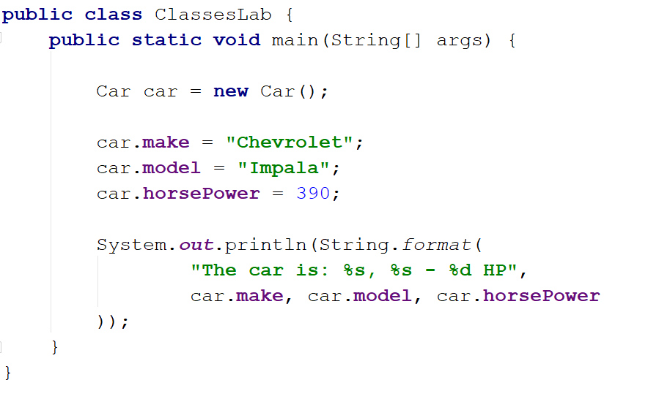
Problem: Define Car Class
Create a class Car
Ensure proper naming!
Class name
Car
Class fields
+make:String
+model:String
+horsePower:int
Class methods
(no actions)

Slide 14
Solution: Define Car Class
public class Car {
String make;
String model;
int horsePower;
}

Slide 15
Access Modifiers
Classes and class members have modifiers
Modifiers define visibility
Class modifier
public class Car {
private String make;
private String model;
}
Fields should always be private!
Member modifier

Slide 16

Methods
Defining a Class Behaviour

Slide 17
Methods
Store executable code (algorithm) that manipulate state
class Car {
private int horsePower;
public void increaseHP(int value) { horsepower+= value;
}
}

Slide 18
Getters and Setters
Used to create accessors and mutators (getters and setters)
class Car {
private int horsePower;
public int getHorsePower() {
return this.horsePower;
}
public void setHorsePower(int horsePower) { this.horsePower = horsePower;
}
}
Field is hidden
Getter provides access to field
this points to the current instance
Setter provide field change

Slide 19
Getters and Setters
Keyword this
prevent field hiding
reffers to a current object
private String horsePower;
public void setSides(int horsePower) { this.horsePower = horsePower; }
public void setSides(int horsePower) { horsePower = horsePower;
}

Slide 20
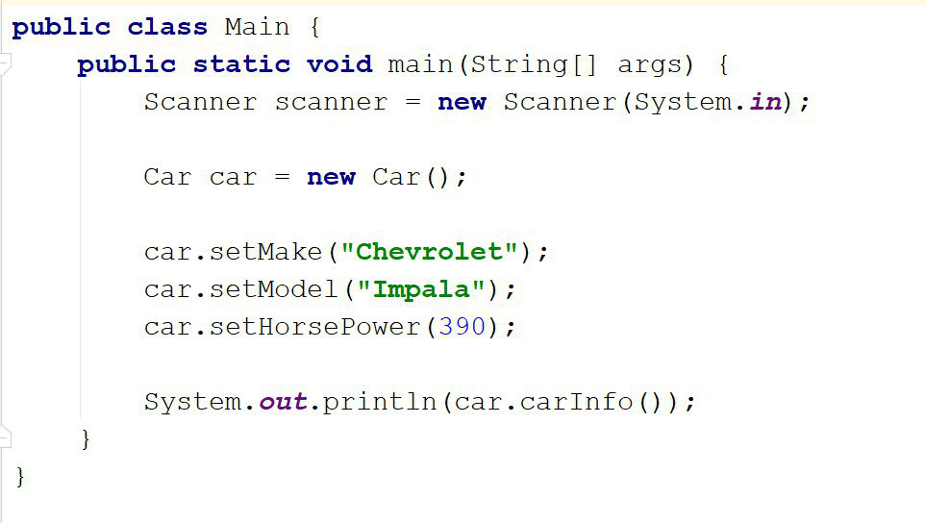
Problem: Car Info
Create a class Car
- == private
Car
-make:String
…
return type
+setMake():void
+getMake():String
+carInfo():String
+ == public
Check your solution here: https://judge.softuni.bg/Contests/Practice/Index/1517#0

Slide 21
Solution: Car Info
public class Car {
private String make;
private String model; private int horsepower;
public void setMake(String make) { this.id = id; }
public double getMake() { return this.make; }
public String carInfo(){ return String.format("The car is: %s %s - %d HP.", this.make, this.model, this.horsePower)
}
}
//TODO test the program
Check your solution here: https://judge.softuni.bg/Contests/Practice/Index/1517#0

Slide 22

Constructors
Object Initialization

Slide 23
Constructors
Special methods, executed during object creation
The only one way to call a constructor in Java is through the keyword new
public class Car {
private String make;
public Car() {
this.make = "BMW";
}
}
Overloading default constructor

Slide 24
Constructors
Special methods, executed during object creation
class Car {
private String make;
…
public Car() {
this.make = "unknown";
…
}
}
Overloading default constructor

Slide 25
Constructors (2)
You can have multiple constructors in the same class
class Car {
int sides;
public Car(String make) {
this.make = make;
}
public Car(String make, int horsepower) {
this.make = make;
this.horsePower = horsePower;
}
}
Constructor with one parameter
Constructor with all parameters

Slide 26
Object Initial State
Constructors set object's initial state
class Car {
String make;
List<Part> parts;
public Car(String make) {
this.make = make;
this.parts = new ArrayList<>();
}
}
Always ensure correct state

Slide 27
Constructor Chaining
Constructors can call each other
class Car {
int make;
public Car(String make, int horsePower) {
this(make);
this.horsePower = horsePower;
}
public Car(String make) {
this.make = make;
}
}

Slide 28
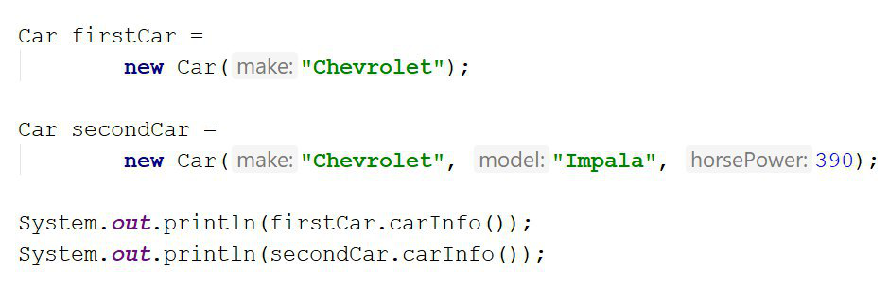
Problem: Constructors
Create a class Car
Car
-make:String
-model:String
-horsePower:int
+Car(String make)
+Car(String make, String model, int horsePower)
+carInfo():String
Check your solution here: https://judge.softuni.bg/Contests/Practice/Index/1517#1

Slide 29
Solution: Constructors
public Car(String make) {
this.make = make;
this.model="unknown";
this.horsePower = -1;
}
public Car(String make, String model, int horsePower) {
this(make);
this.model = model;
this.horsePower = horsePower;
}
Check your solution here: https://judge.softuni.bg/Contests/Practice/Index/1517#1

Slide 30

Static Members
Members Common for the Class

Slide 31
Static Members
Access static members through the class name
Static members are shared class-wide
You don't need an instance
class Program {
public static void main(String[] args) {
BankAccount.setInterestRate(2.2);
}
}
Sets the rate for all bank accounts

Slide 32
Static Members
class BankAccount {
private static int accountsCount;
private static double interestRate;
public BankAccount()) {
accountsCount++;
}
public static void setInterestRate(double rate) {
interestRate = rate;
}
}

Slide 33
Problem: Bank Account
BankAccount
Create a class BankAccount
Support commands:
Create
Deposit {ID} {Amount}
SetInterest {Interest}
GetInterest {ID} {Years}
End
-id:int (starts from 1)
-balance:double
-interestRate:double (default: 0.02)
underline == static
+setInterest(double interest):void
+getInterest(int years):double
+deposit(double amount):void
Create
Deposit 1 20
GetInterest 1 10
End
Account ID1 Created
Deposited 20 to ID1
4.00
(20 * 0.02) * 10
Check your solution here: https://judge.softuni.bg/Contests/Practice/Index/1517#2

Slide 34
Solution: Bank Account
public class BankAccount {
private final static double DEFAULT_INTEREST = 0.02;
private static double rate = DEFAULT_INTEREST;
private static int bankAccountsCount;
private int id;
private double balance;
// continue…
}
Check your solution here: https://judge.softuni.bg/Contests/Practice/Index/1517#2

Slide 35
Solution: Bank Account (2)
public class BankAccount {
// continued…
public BankAccount() {
this.id = ++bankAccountsCount;
}
public static void setInterest(double interest) {
rate = interest;
}
// TODO: override toString()
// TODO: void deposit(double amount) // TODO: double getInterest(int years)
}
Check your solution here: https://judge.softuni.bg/Contests/Practice/Index/1517#2

Slide 36
Solution: Bank Account (2)
HashMap<String, BankAccount> bankAccounts = new HashMap<>();
while (!command.equals("End")) {
// TODO: Get command args
switch (cmdType) {
case "Create": // TODO
case "Deposit": // TODO
case "SetInterest": // TODO
case "GetInterest": // TODO
// TODO: Read command
}
Check your solution here: https://judge.softuni.bg/Contests/Practice/Index/1517#2

Slide 37

Summary
…
…
…
Classes define specific structure for objects
Objects are particular instances of a class
Classes define fields, methods, constructors and other members
Constructors are invoked when creating new class instances
Constructors initialize the object's initial state

Slide 38
https://softuni.bg/trainings/courses

Slide 39













SoftUni Diamond Partners

Slide 40




SoftUni Organizational Partners

Slide 41




Trainings @ Software University (SoftUni)
Software University – High-Quality Education and Employment Opportunities
softuni.bg
Software University Foundation
http://softuni.foundation/
Software University @ Facebook
facebook.com/SoftwareUniversity
Software University Forums
forum.softuni.bg

Slide 42

License
This course (slides, examples, demos, videos, homework, etc.) is licensed under the "Creative Commons Attribution-NonCommercial-ShareAlike 4.0 International" license

